Slide 1

COMP 5350 / 6350 / 6356 Digital Forensics Spring 2019

Slide 2
Homework #3

Slide 3
Homework #3
Using the fdisk utility:
Create a thumb drive with 2 equally sized FAT16 partitions
Set the 2nd partition to bootable
Complete the following tasks:
Specify how many sectors are on each partition
2) Using hexdump print out the boot sector for the 2nd partition
3) Specify how many sectors are in each of the following:
Reserved Area
1st FAT Area
2nd FAT Area
Root Directory
Data Area
Create a word document that answers each of the questions and add any necessary screenshots to back up your answers
Homework #3 is due 1 February 11:59 PM

Slide 4
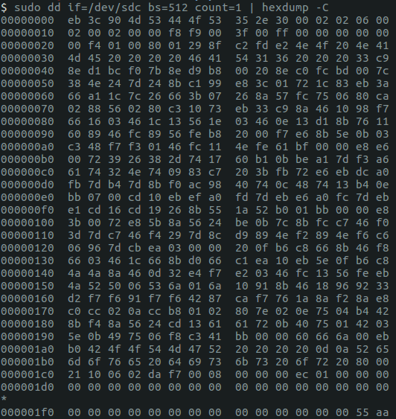
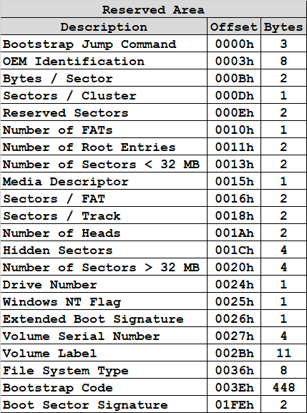
FAT16 Boot Sector

Slide 5
Homework #3 Considerations
Creating a FAT16 partition has two steps when using the virtual machine
Creating a FAT16 container with fdisk
Creating the actual partition with mkfs
FAT16 has a maximum partition size of 2 GB (4 GB)
FAT16 requires a cluster size of 4085 - 65525
File System | File Size | Partition Size | File Permissions
FAT12 | 16 MiB | 16 MiB
FAT16 | 2 GiB | 2 GiB
FAT32 | 4 GiB | 8 TiB

Slide 6
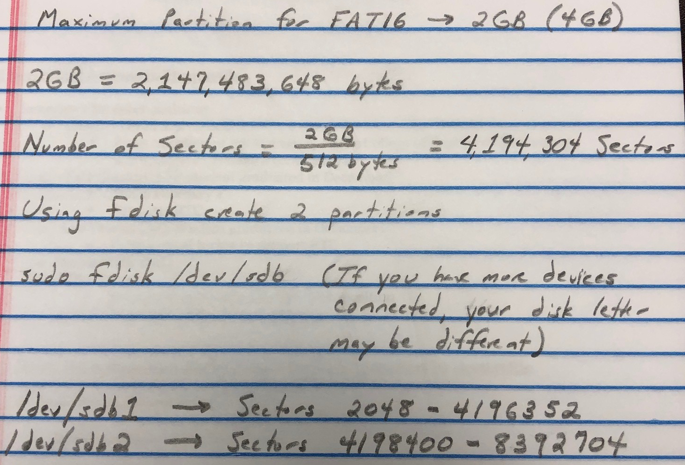
HW #3 Details

Slide 7
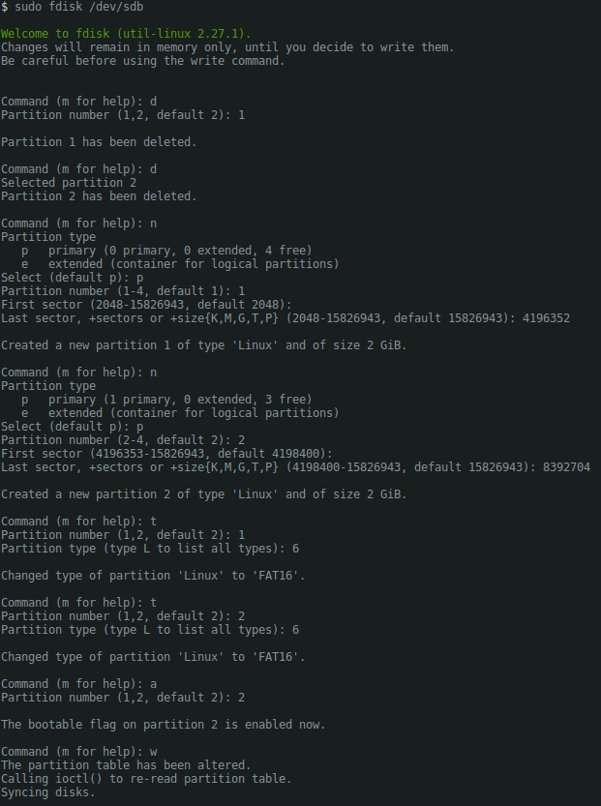
HW #3: Correct Process

Slide 8
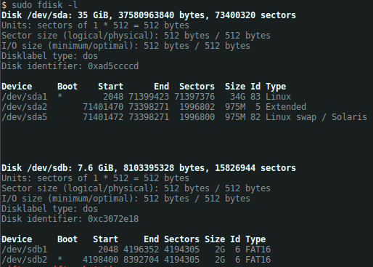
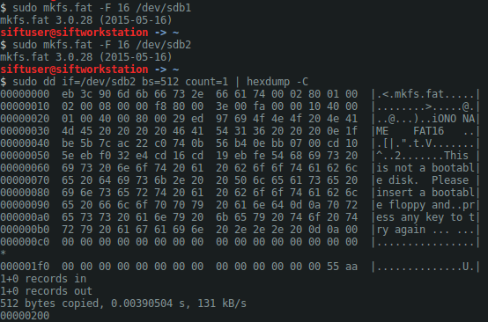
HW #3: Correct Process

Slide 9
HW #3: Correct Process
Reserved Area – 0x0001 – 1 Sector
Number of FATs – 0x02 – 2 FATs
Number of Root Entries – 0x0800 – 2048 Directory Entries
-> (2048*32)/512 = 128 Sectors
Sectors / FAT – 0x0080 – 128 Sectors
Total Sectors – 0x00400001 – 4,194,305 Sectors
Data Area Sectors -> 4,194,305 – 1 – 128 – 128 – 128
-> 4,193,920

Slide 10
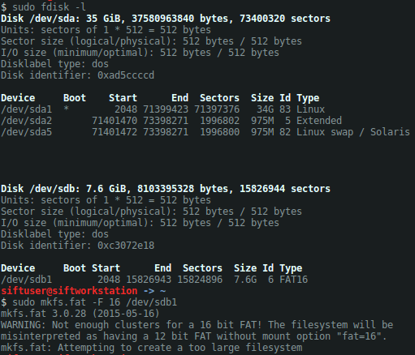
HW #3: Potential Problems
Maximum Partition Size

Slide 11
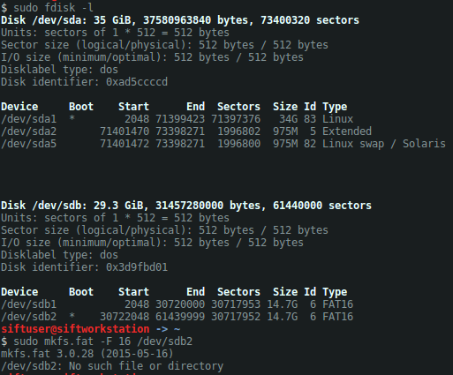
HW #3: Potential Problems
Maximum Partition Size

Slide 12
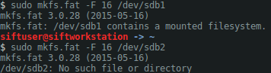
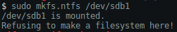
HW #3: Potential Problems
Mounted File System

Slide 13
New Technology File System Introduction

Slide 14
File System Abstraction
DISK
PARTITION
FILE SYSTEM
DATA UNIT
METADATA
FILE NAME

Slide 15
File System Partition Comparisons
File System | File Size | Partition Size | File Permissions
FAT12 | 16 MiB | 16 MiB
FAT16 | 2 GiB | 2 GiB
FAT32 | 4 GiB | 8 TiB
NTFS | 2 TiB | 256 TiB | X
ext2 | 2 TiB | 32 TiB | X
ext3 | 2 TiB | 32 TiB | X
ext4 | 16 TiB | 1 EiB | X
HFS+ | 2 GiB | 2 TiB | X
XFS | 8 EiB | 8 EiB | X

Slide 16
NTFS
The New Technology File System is a more complex file system versus FAT file systems
The operating systems designed for use with NTFS include:
Windows 98
Windows NT
Windows 2000
Windows XP
Windows 7
Windows 8
Windows 10
The objective of the NTFS design was to provide greater functionality over traditional FAT file systems
Reliability
Security
Large Storage Device Support

Slide 17
Differences Between FAT and NTFS
Some of the key differences between FAT and NTFS:
 | FAT16 | FAT32 | NTFS
Volume Size (Max) | 2 GB - 4 GB | 32 GB - 2 TB | 2 TB
File Size (Max) | 2 GB | 4 GB | 16 EB
File Name Length (Max) | 8.3 / < 255 chars | < 255 chars | < 255
Encoding | System | System | Unicode
Compression | No | No | Yes
Encryption | No | No | Yes
File Permissions | No | No | Yes
Built-In Security | No | No | Yes
Fault Tolerance | No | Minimal | Yes

Slide 18
NTFS Version Capabilities
Version 1.0
Windows NT 3.1, 1993
Version 1.1
Windows NT 3.51, 1995
File Compression
Named Streams
Access Control Lists
Version 1.2
Windows NT 4.0, 1996
Security Descriptors
Version 3.0
Windows 2000, 2000
Disk Quotas
Encrypting File System
Sparse Files
Reparse Points
Update Sequence Number (USN) Journaling
Reorganized Security Descriptors
Version 3.1
Expanded the Master File Table (MFT) Entries

Slide 19
NTFS Capability Definitions
Self-healing
Detection and correction of volume corruption without running disk repair utility
Access Control Lists (ACL)
Administrator set system permissions with ACLs to preemptively identify resource access
Encrypting File System (EFS)
NTFS utilized DESX to provide file encryption
Disk Quotas
Tracking of user disk utilization and restrictive use of user disk space
Fault Tolerance
NTFS File Systems automatically performs recovery operations through the use of transaction logs and journal files

Slide 20
NTFS Capability Definitions (con’t)
File Compression
NTFS utilizes the Lempel-Ziv compression algorithm to compress large files and make more efficient use of disk space
Alternate Data Streams (ADS)
ADSs are areas where additional, non-critical, information about files can be stored
Security Descriptors
NTFS provides attributes that define all security definitions of a file or directory
Sparse Files
Disk allocation is only allocated to files unless it contains nonzero data
Reparse Points
NTFS provides a capability to link paths similar to symbolic links
Update Sequence Number (USN) Journaling
Recording of all changes made to a volume

Slide 21
NTFS Partition Configuration

Slide 22
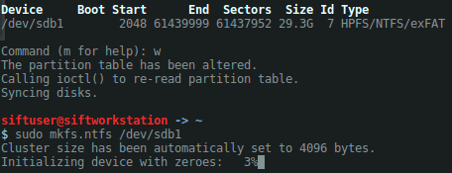
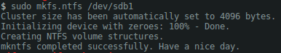
Creation of NTFS Partition

Slide 23
Organization of NTFS Partitions
The overall structure of NTFS partitions includes:
Master Boot Record
Master File Table
File Data
Master File Table Backup
Master
Boot
Record
Master
File
Table
File
Data
Area
Master
File
Table
Backup

Slide 24
NTFS Master Boot Record

Slide 25
NTFS Master Boot Record
The Master Boot Record (MBR) is the first sector on an NTFS formatted disk
The MBR contains the partition table for the disk and a small amount of executable code similar to the FAT boot sector
The MBR finds the starting point of the partition and loads a copy the boot sector into memory
Master
Boot
Record
Master
File
Table
File
Data
Area
Master
File
Table
Backup

Slide 26
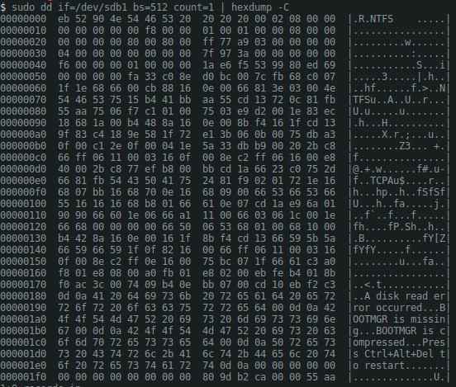
NTFS Master Boot Record
Master
Boot
Record
Master
File
Table
File
Data
Area
Master
File
Table
Backup

Slide 27
FAT vs. NTFS Boot Sector
*
*
*
*
*
*

Slide 28
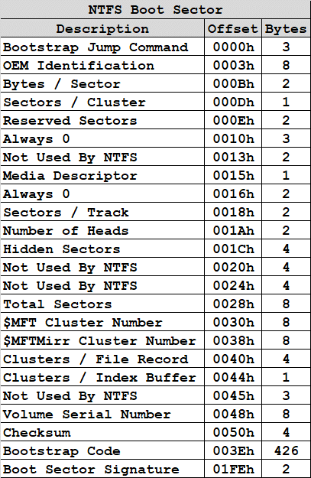
Master Boot Record - Bootstrap
B
0xEB3C90: Jump Short 52 NOP

Slide 29
Master Boot Record – OEM ID
B
0x4E54465320202020: “NTFS “

Slide 30
Master Boot Record – Bytes / Sector
L
0x0200: 512 Bytes / Sector

Slide 31
Master Boot Record – Sectors / Cluster
L
0x08: 8 Sectors / Cluster

Slide 32
Master Boot Record – Reserved Sectors
L
0x0000: 0 Reserved Sectors

Slide 33
Master Boot Record – Set to 0
L
0x000000

Slide 34
Master Boot Record – Not Used By NTFS
L
0x0000

Slide 35
Master Boot Record – Media Descriptor
L
0xF8: Fixed disk – Hard Disk Partition

Slide 36
Master Boot Record – Always 0
L
0x0000

Slide 37
Master Boot Record – Sectors / Track
L
0x0001: 1 Sector / Track

Slide 38
Master Boot Record – Heads
L
0x0001: 1 Head

Slide 39
Master Boot Record – Hidden Sectors
L
0x00000800: 2048 Hidden Sectors

Slide 40
Master Boot Record – Not Used By NTFS
L
0x00000000

Slide 41
Master Boot Record – Not Used By NTFS
L
0x00800080

Slide 42
Master Boot Record – Total Sectors
L
0x0000000003A977FF: 61437951 Sectors

Slide 43
Master Boot Record – $MFT Cluster Number
L
0x0000000000000004: $MFT Cluster Number - 4

Slide 44
Master Boot Record – $MFT Cluster Number
0x0000000000000004: $MFT Cluster Number – 4
4096 bytes / cluster * 4 clusters
$MFT Located 16,384 bytes into partition

Slide 45
Master Boot Record – $MFTMirr Cluster Number
L
0x00000000003A977F: $MFTMirr Cluster Number - 3839871

Slide 46
Master Boot Record – $MFTMirr Cluster Number
0x00000000003A977F: $MFTMirr Cluster Number – 3,839,871
4096 bytes / cluster * 3,839,871 clusters
$MFTMirr Located 15,728,111,616 bytes into partition

Slide 47
Master Boot Record – Clusters / File Record
L
0x000000F6: 246 Clusters / File

Slide 48
Master Boot Record – Clusters / Index
L
0x01: 1 Cluster / Index

Slide 49
Master Boot Record – Not Used By NTFS
L
0x000000

Slide 50
Master Boot Record – Volume Serial Number
L
0x69ED809953F5E61A

Slide 51
Master Boot Record – Checksum
L
0x000000: 0

Slide 52
Master Boot Record – Bootstrap Code
L

Slide 53
Master Boot Record – Boot Sector Signature
L
0xAA55

Slide 54
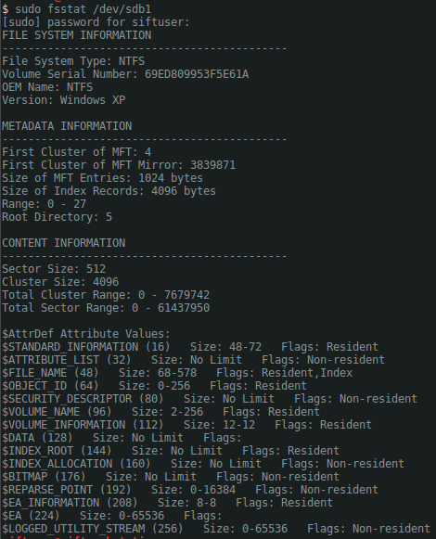
Master Boot Record – FS Statistics
Boot Record Data
OEM ID
NTFS
Sector Size
512 Bytes
Total Sectors
61437950
Volume Serial Number
69ED809953F5E61A
$MFT Cluster
4th Cluster
$MFTMirr Cluster
3839871th Cluster
Cluster Size
4096 Bytes

Slide 55
NTFS Master File Table

Slide 56
Master File Table
Master
Boot
Record
Master
File
Table
File
Data
Area
Master
File
Table
Backup
1024 bytes
A Master File Table is composed of entries for every data object including files, folders, and applications
MFT entries contain all information necessary to completely describe each file and folder in the file system
Each entry in the MFT is 1024 bytes long
The MFT itself is a file

Slide 57
Master File Table
Master
Boot
Record
Master
File
Table
File
Data
Area
Master
File
Table
Backup
Unlike legacy file systems, such as FAT, NTFS provides significant expansion about files and directories through the use of attributes
Compression
Encryption
Security
The MFT initially accounts for 1/8 of the overall size of the NTFS partition and can grow to 1/2
If an MFT entry grows larger than 1024 bytes, additional entries will be added

Slide 58
Master File Table
Master
Boot
Record
Master
File
Table
File
Data
Area
Master
File
Table
Backup
MFT Entry
$MFT
MFT Entry
MFT Entry
MFT Entry
Attribute
Headers
MFT
Entry
Header
Unused
Space
Attributes

Slide 59
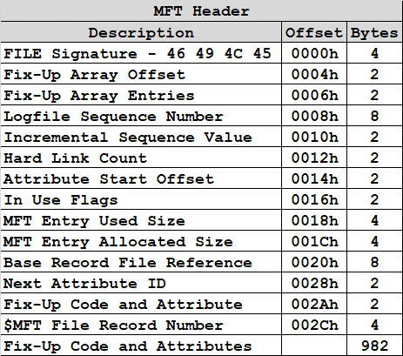
Master File Table Entry
Although each entry of the MFT is 1024 bytes, the first 42 bytes make up the MFT header
The first 512 bytes of an MFT entry contain a files metadata attributes
For files that are 512 bytes and less, the second 512 bytes can be used to store a file in the MFT entry
The first 25 MFT entries are reserved for system files
MFT
Entry
Header
MFT
Metadata
Attributes
MFT
Resident
Data
AH
Attribute
AH
Attribute
AH
Attribute
42
bytes
512
bytes
512
bytes

Slide 60
Master File Table Entry Definitions
Fix-Up Array
Since file system sectors have the potential for corruption, NTFS needs a way to detect cluster errors
Fix-Up arrays help to detect errors and are maintained by sequence numbers
Logfile Sequence Number
A tracking number that changes every time a record is modified
Sequence Number
Number of times the MFT record has been reused
Hard Link Count
A hard link is used to count the number of directory entries for the current record

Slide 61
Master File Table Entry Definitions
Attribute Start Offset
How many bytes until reaching the next attribute
Flags
The flags in a MFT header specify the status of the object
0x01 - Record In Use
0x02 - Directory
0x04 - Don’t Know
0x08 - Don’t Know
Allocated Size
How much space the record takes up on disk
Usually a multiple of the cluster size
Base Record File Reference
Zero for base MFT records
Non-zero when a MFT reference

Slide 62
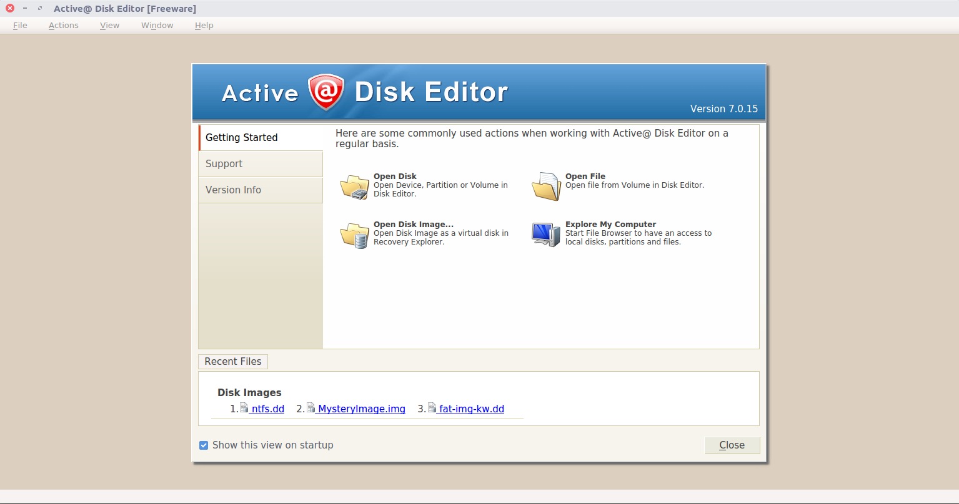
Master File Table Entry – Disk Editor

Slide 63
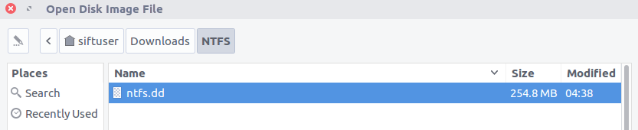
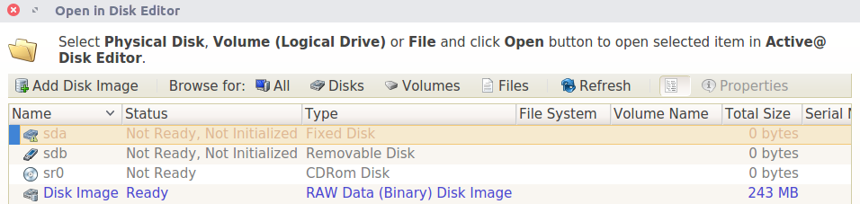
Adding Images – Disk Editor

Slide 64
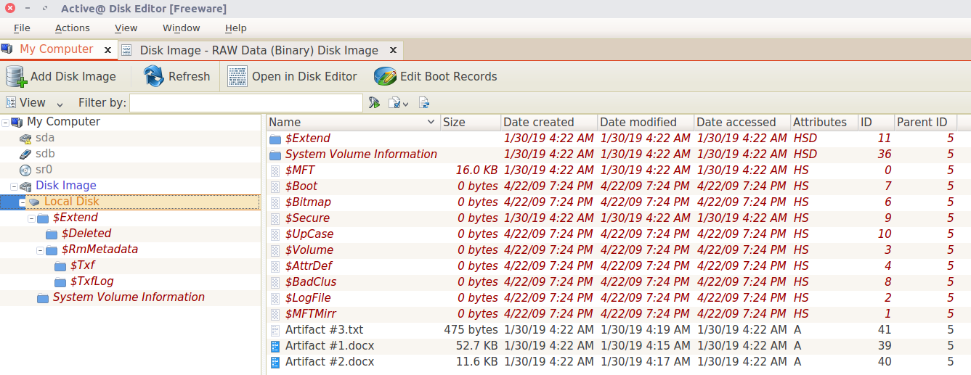
NTFS Image Analysis – Disk Editor
A 273 MB disk was formatted with NTFS and three files were added
1 file of 475 bytes - Resident
1 file of 11.k KB – Non-Resident
2 file of 52.7 KB – Non-Resident
No files were modified or deleted
The objective is to understand $MFT contents and how data is managed

Slide 65
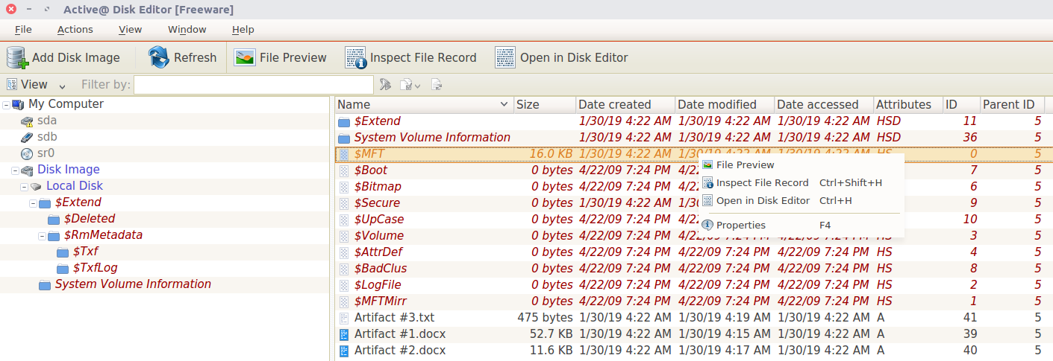
NTFS Image Analysis
Instead of utilizing only hexdump analysis, we will make use of file record templates
Each item appended with $ indicate file metadata objects

Slide 66
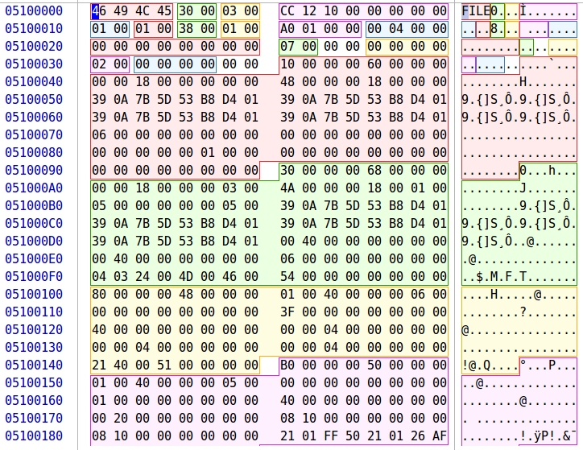
$MFT
Offset to first attribute
0x0038
Flags
0x0001 - Record in Use
Used Size of MFT Record
0x000001A0 – 416 bytes
Next Attribute ID
0x0007 - $Boot

Slide 67
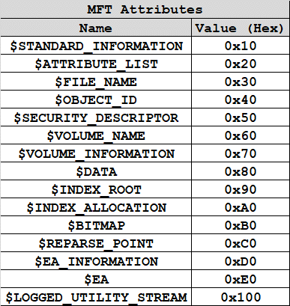
MFT Attribute Type Identifiers
Which attributes does the MFT entry for the MFT file have?

Slide 68
Standard File Attributes

Slide 69
NTFS Attributes
The NTFS file system defines each object as a file along with a set of file attributes
Elements such as the file's name, data, creation and modification time, and security information are file attributes
Each attribute is denoted with a unique attribute type value and attribute name
When a file's attributes and data can fit into the 1024 bytes of the MFT file record they are called resident
If a file's attributes and data can not fit into the MFT file record they are called non-resident
For non-resident attributes, it is necessary to allocated one or more clusters of disk space
If a MFT record grows beyond the allocated 1024 bytes additional MFT records will be added and will generate an attribute list, which is also an attribute itself

Slide 70
NTFS Attribute Descriptions
$STANDARD_INFORMATION
Timestamp and link information
$FILE_NAME
Information relative to short (8.3) or long (Unicode) filenames
Hard link information
$DATA
Raw file data
$ATTRIBUTE_LIST
Lists the location of all attribute records that do not fit in the MFT record.
$SECURITY_DESCRIPTOR
File ownership and access information
$OBJECT_ID
Provides a global tracking identifier for files

Slide 71
NTFS Attribute Descriptions
$REPARSE_POINT
Used for volume mount points
$INDEX_ROOT, $INDEX_ALLOCATION, $BITMAP
Used to implement folders and other indexes
$VOLUME_INFORMATION
Volume version information
$VOLUME_NAME
Volume label information

Slide 72
$STANDARD_INFORMATION Attribute
The $SI attribute exists for every file and directory and is always resident
The $SI attribute type identifier is 16
The elements of the $SI attribute are non-essential and include:
Creation Time
File Altered Time
MFT Altered Time
File Accessed Time
Flags
Maximum Versions
Version Number
Class ID
Owner ID
Security ID
Quota
Update Sequence Number

Slide 73
$STANDARD_INFORMATION Flags
All flags are non-essential
The $SI flags include:
0x0001 – Read Only
0x0002 – Hidden
0x0004 – System
0x0020 – Archive
0x0040 – Device
0x0080 – Normal
0x0100 – Temporary
0x0200 – Sparse File
0x0400 – Reparse Point
0x0800 – Compressed
0x1000 – Offline
0x2000 – Non-Indexed
0x4000 - Encrypted

Slide 74
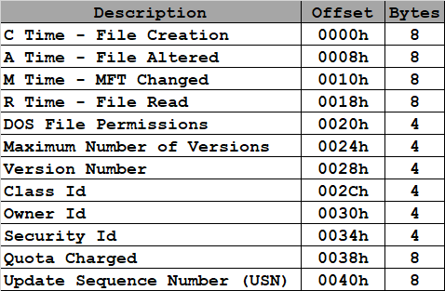
$STANDARD_INFORMATION – 0x0010

Slide 75
$FILE_NAME Attribute
The $FN attribute is used to:
Placed in an MFT entry to store the file’s name and parent directory information
Store data in a directory index
The $FN attribute type identifier is 48
The elements of the $FN attribute:
File Reference or Parent Directory - N
File Creation Time - N
File Modification Time - N
MFT Modification Time - N
File Access Time - N
Allocates Size of File - N
Real Size of File - N
Flags - N
Reparse Value - N
Length of Name – Y for Directory Index
Namespace - Y for Directory Index
Name - Y for Directory Index

Slide 76
$FILE_NAME Flags
All flags are non-essential
The $SI flags include:
0x0001 – Read Only
0x0002 – Hidden
0x0004 – System
0x0020 – Archive
0x0040 – Device
0x0080 – Normal
0x0100 – Temporary
0x0200 – Sparse File
0x0400 – Reparse Point
0x0800 – Compressed
0x1000 – Offline
0x2000 – Non-Indexed
0x4000 - Encrypted

Slide 77
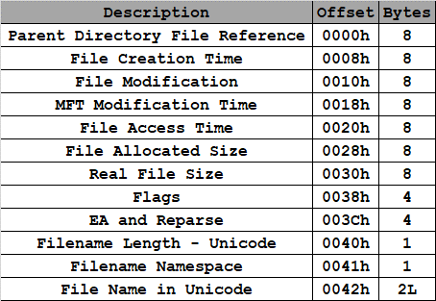
$FILE_NAME - 0x0030

Slide 78
$DATA Attribute
The $DATA attribute does not have a structure
After the header, the remaining data corresponds to raw data of the file itself
The $DATA type identifier is 128
$DATA has no minimum or maximum size
Raw data over 700 bytes in size is non-resident
For most files, the $DATA attribute is the last attribute in the MFT entry

Slide 79
$DATA - 0x0080

Slide 80
Forensic Image Formats and Utilities

Slide 81
Disk Image Formats
Why do we need to have a specific format for storage media?
Acquisition Time
Method of Acquisition
Size
Errors
Hashes
Compression
Encryption

Slide 82
Survey of Disk Image Storage Formats
The Common Digital Evidence Storage Format (CDESF) Working Group of the Digital Forensics Research Workshop produced a paper that surveyed the commonly used forensic file formats
Throughout the course we will work with each of the following formats to understand their benefits and drawbacks:
Raw
Advanced Forensic Format (AFF)
Digital Evidence Bag (DEB)
Expert Witness Format (EWF)
Gfzip
ProDiscover
SMART

Slide 83
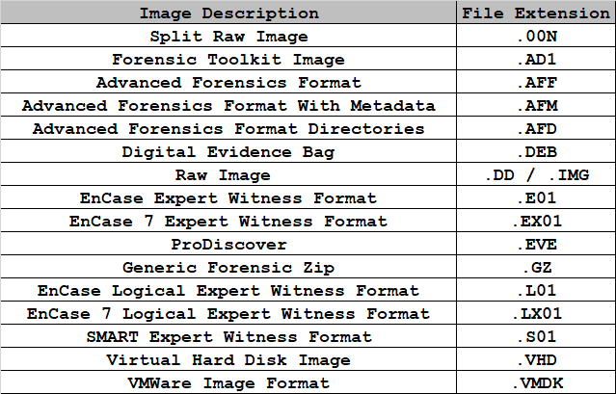
Disk Image Storage Format Extensions

Slide 84
Raw vs. Forensics Images
It is important to realize that legacy raw images are not technically a format
Unlike forensic images, raw images are raw data chunks and do not contain metadata
Raw images do not provide information about:
File names
Sizes
Timestamps
Inode Information
Raw images are usually identified by .img and .dd extensions
Raw image collection can be accomplished with different variants of the dd utility
dd
dcfldd
dc3dd

Slide 85
dd Utility
Copy a file, converting and formatting according to the operands
The original version of dd failed to provide:
Automated Hashing
Error Handling
Image Logging
Image Verification
dcfldd
Developed by the Department of Defense Computer Forensics Lab (DCFL)
Enhanced version of GNU dd with features useful for forensics and security
dc3dd
Developed by the Department of Defense Cyber Crime Center (DC3)
Patched version of GNU dd with added features for computer

Slide 86
dd Utility Genealogy
dd
dc3dd
Department of Defense Cyber Crime Center
Produces raw images only
Patch of dd
Enhancements
Automated Image Hashing
Optional Piecewise Image Hashing
Error Checking and Logging
Pattern Wiping
Image Verification
Progress Reporting
Split Image Output
Direct I/O mode
dcfldd
Department of Defense Computer Forensics Lab
Produces raw images only
Fork of dd
Enhancements
Automated Image Hashing
Optional Piecewise Image Hashing
Error Checking and Logging
Pattern Wiping
Image Verification
Progress Reporting
Split Image Output
Supports larger set of hashing algorithms

Slide 87
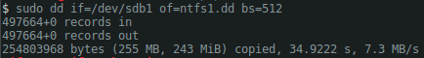
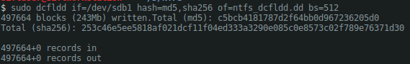
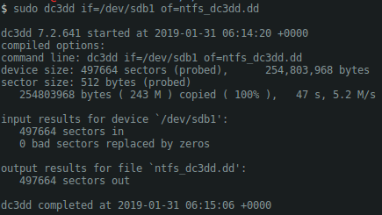
dd Variant Examples
dd
dcfldd
dc3dd

Slide 88
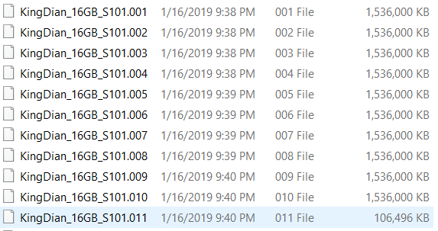
Split Raw Images
.00n extension
When images go above a specified size, they are broken into equal size portions

Slide 89
Advanced Forensics Format
.aff extension
AFF was created as an open file format to store disk images and metadata
The format was implemented in AFFLIB which was distributed with an open source license
AFF supports image compression
zlib
LZMA
Files saved with these compression algorithms are are anywhere from 1/2 to 1/10th the size of the original AFF/EnCase file
AFF2.0 supports encryption of disk images
FTK Imager/FTK added support for this encryption in version 3.0 and are able to create and access AFF encrypted images

Slide 90
EnCase Expert Witness Format
.E01 Extension
EnCase has expanded since its introduction and includes a wide variety of updated formats including:
EnCase 7 Expert Witness Format
.EX01 Extension
EnCase Logical Expert Witness Format
.L01 Extension
EnCase 7 Logical Expert Witness Format
.LX01 Extension
SMART Expert Witness Format
.S01 Extension

Slide 91
Disk Image Capture

Slide 92
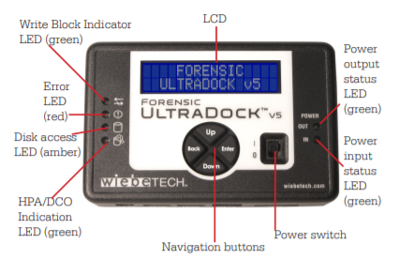
Write Blocker Hardware
There are a wide variety of hardware write blockers available
Hardware can be configured to run on either the host or guest machine
If running on the host, ensure shared directories are configured to allow for easy access on the guest

Slide 93
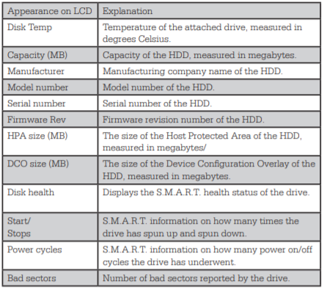
Write Blocker Interface
The following disk information is available on the display

Slide 94
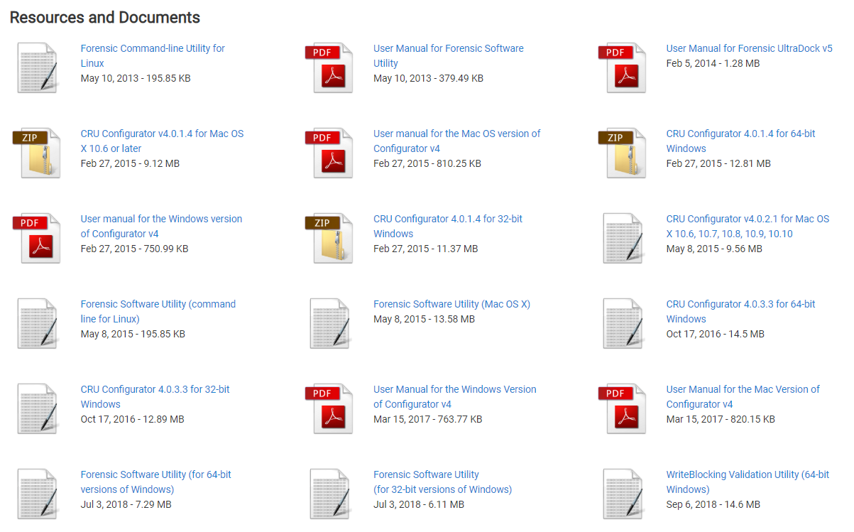
Write Blocker Resources
Necessary resources can be found below:
https://www.cru-inc.com/products/wiebetech/wiebetech_forensic_ultradock_v5

Slide 95
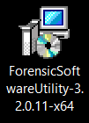
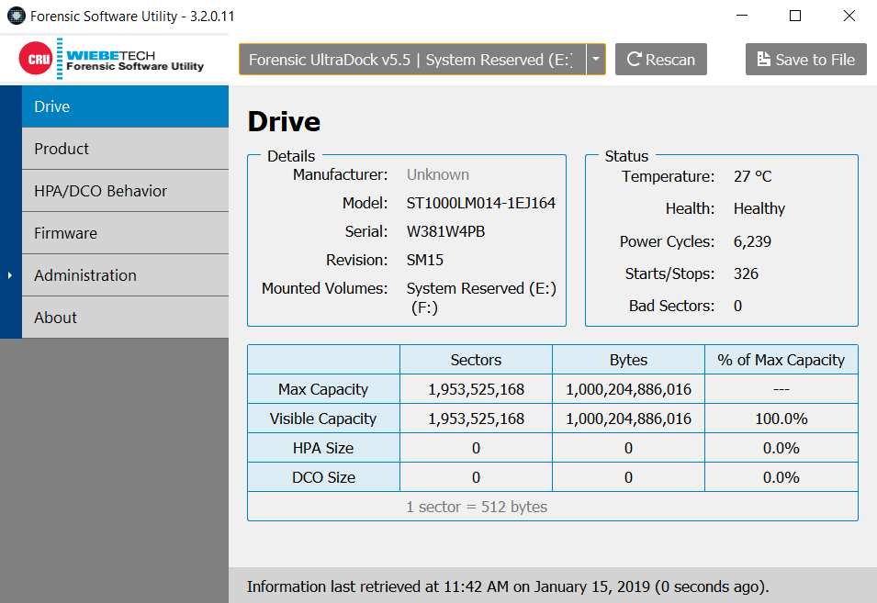
Forensic Software Utility
Install and test forensic software utility:

Slide 96
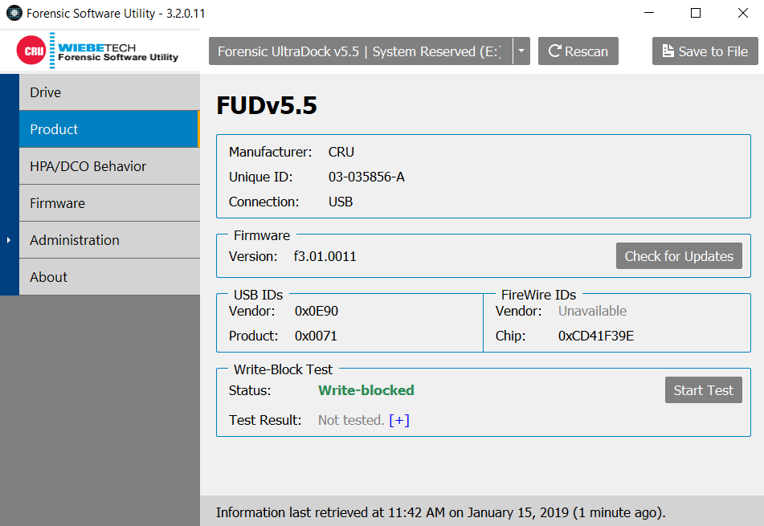
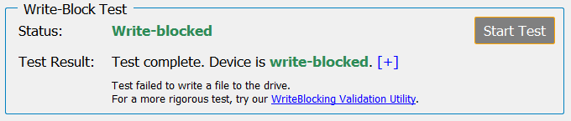
Write Block Test

Slide 97
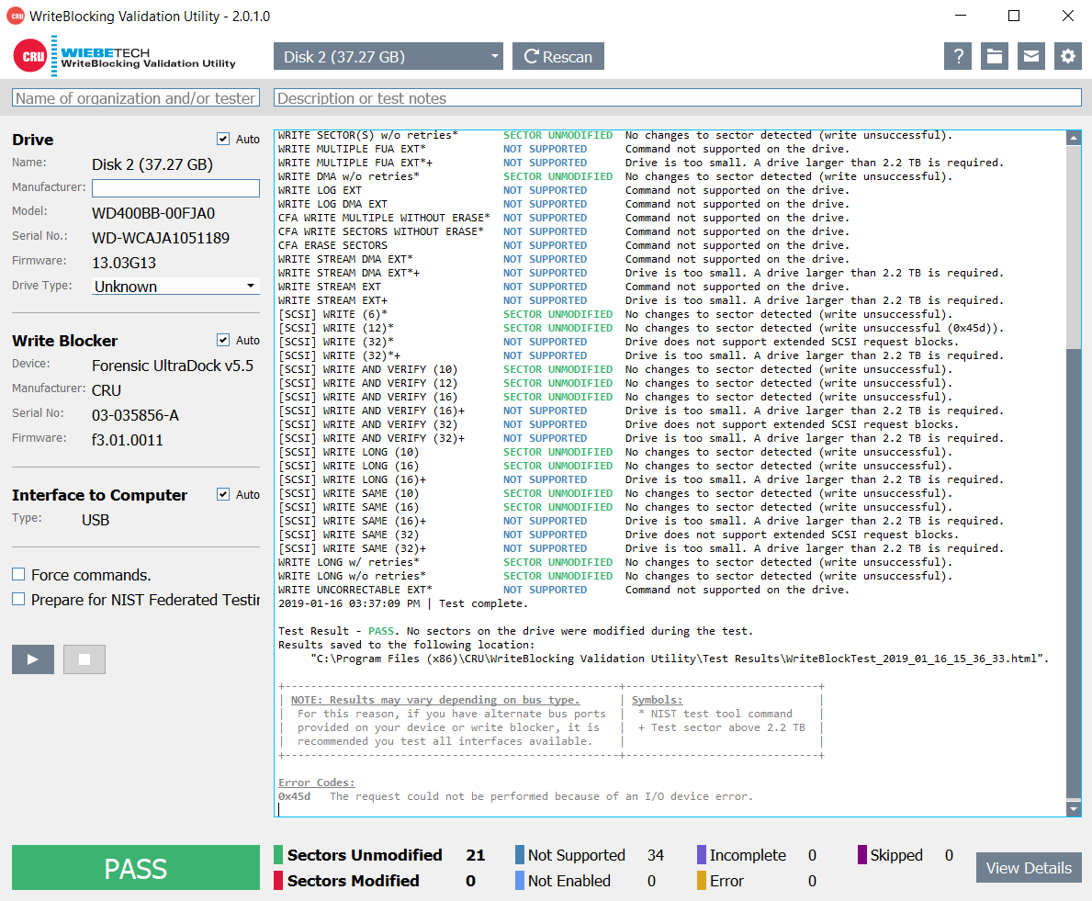
Write Block Test

Slide 98
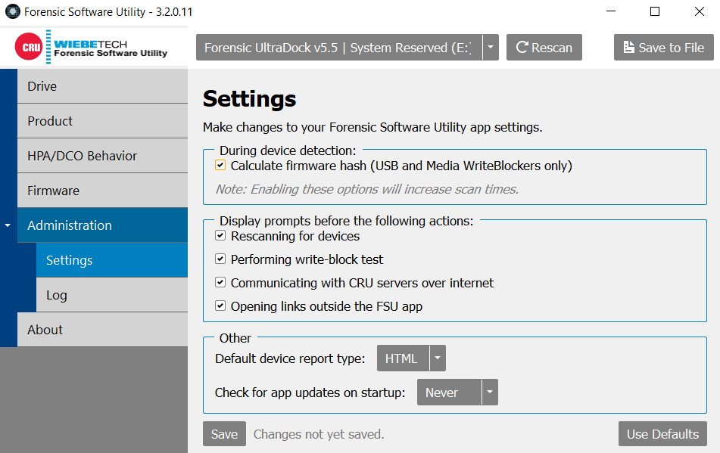
Disk Collection Settings

Slide 99
Disk Imagers
With the write blocker mechanism in place and operating, the next step is to install a disk imager
There are numerous disk imagers available so being familiar with some of the more common will be helpful in maximizing collection and analysis capabilities
Common disk image collectors:
Unix-based
dd, dcfldd, dc3dd
aimage
Windows-based
EnCase
FTK Imager
Ghost
Belkasoft

Slide 100
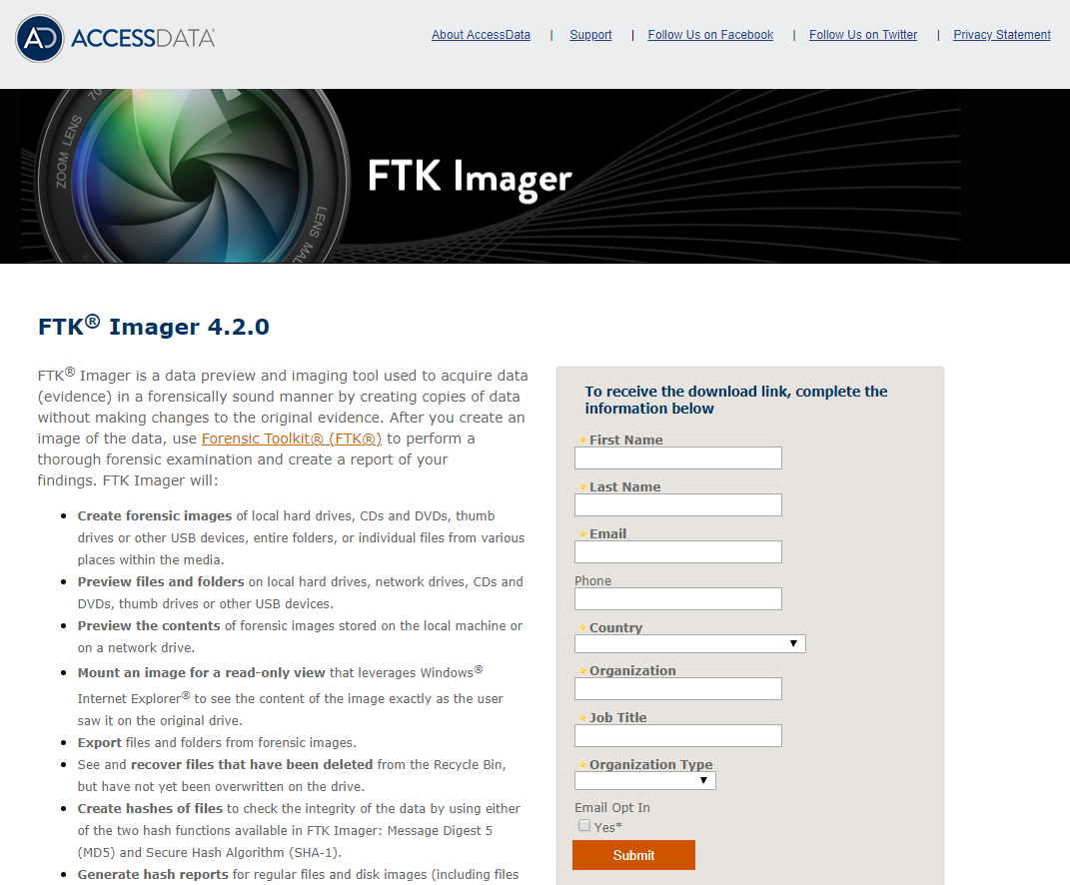
FTK Imager
https://marketing.accessdata.com/ftkimager4.2.0

Slide 101
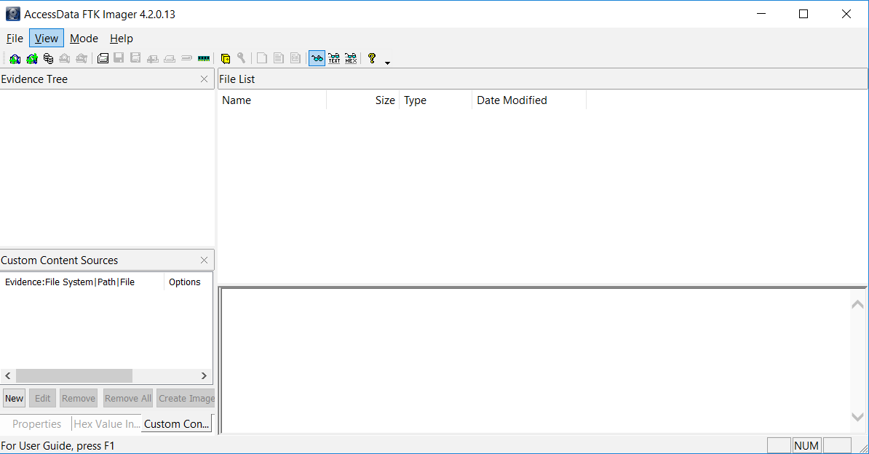
Disk Imager Interface

Slide 102
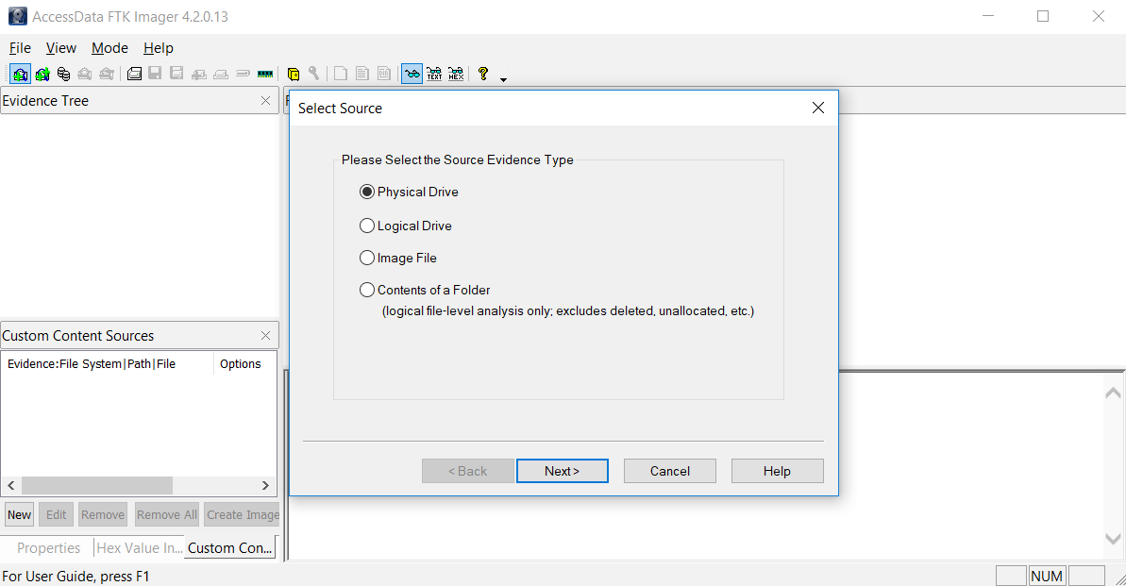
Add Evidence
Physical Drive
Logical Drive
Image File
Contents of a Folder

Slide 103
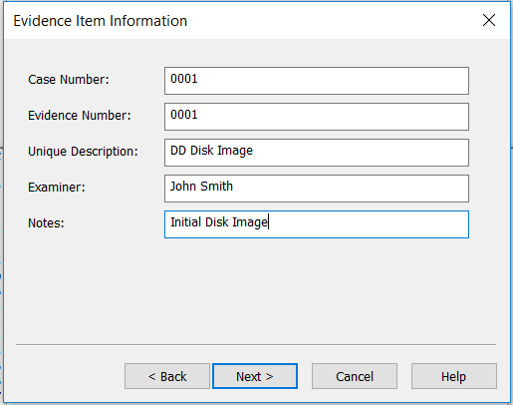
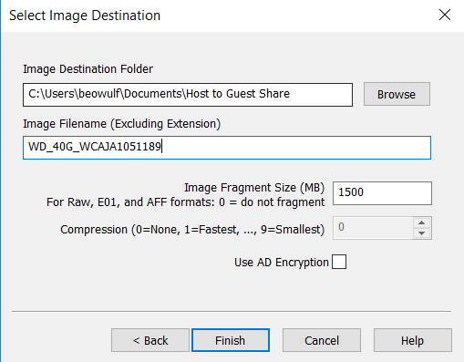
Create Disk Image

Slide 104
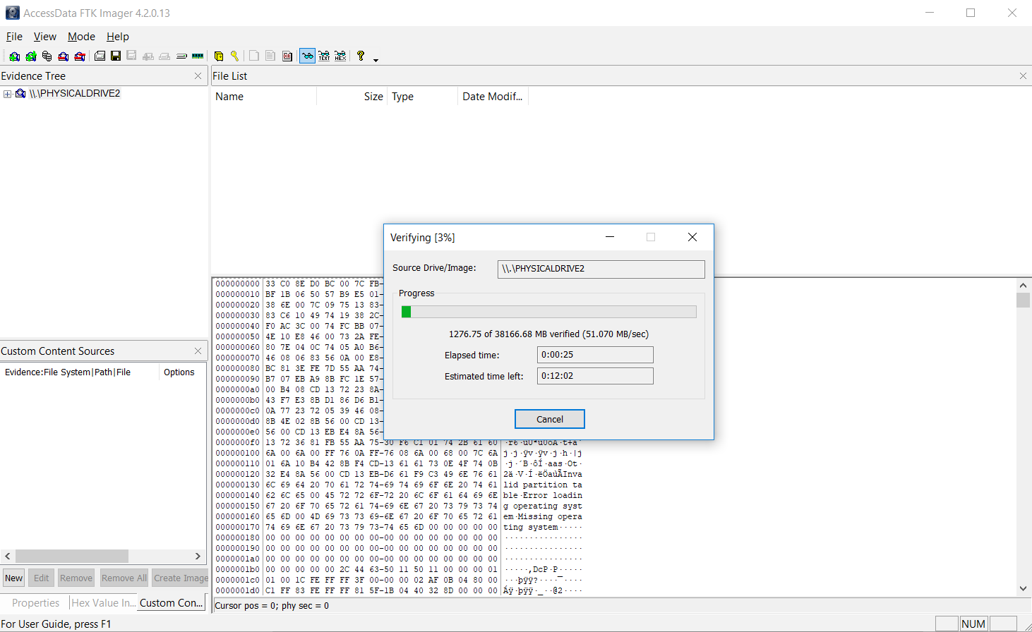
Verify Disk / Image

Slide 105
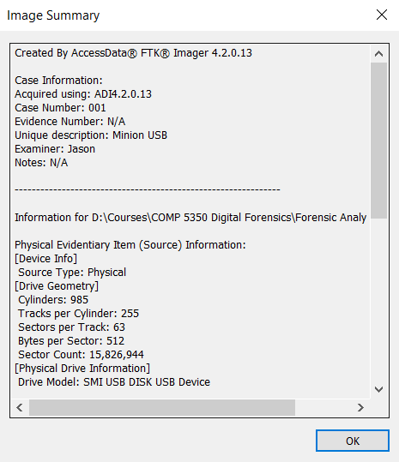
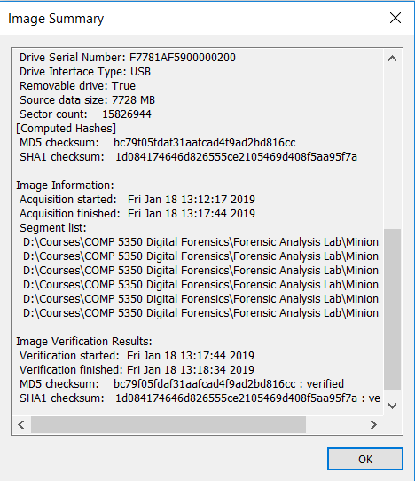
Confirm Results

Slide 106
References
File System Forensic Analysis, Carrier, 2005
NTFS
http://ntfs.com/ntfs_basics.htm
Unicode
http://www.unicode.org/standard/WhatIsUnicode.html

